Slide 1

Microsoft movie production suggestion analysis

Slide 2
Overview
This project analyzes what type of content , films ,genres that are popular among the viewers and are doing well at the box office.

Slide 3
Outline
Business Problem
Data and Methods
Results
Conclusions

Slide 4
Business Problem
Microsoft wants to venture into film production which is a new space to them. Therefore, Microsoft needs insights on which content and type of films doing well at the box office so they can hope into the wagon of creating original video content and don’t miss out on all fun.

Slide 5
Data and methods
The data used for analysis includes 4 CSV files , the files contain information on movies and film titles and their attributes like release date , genres , language, among others.

Slide 6
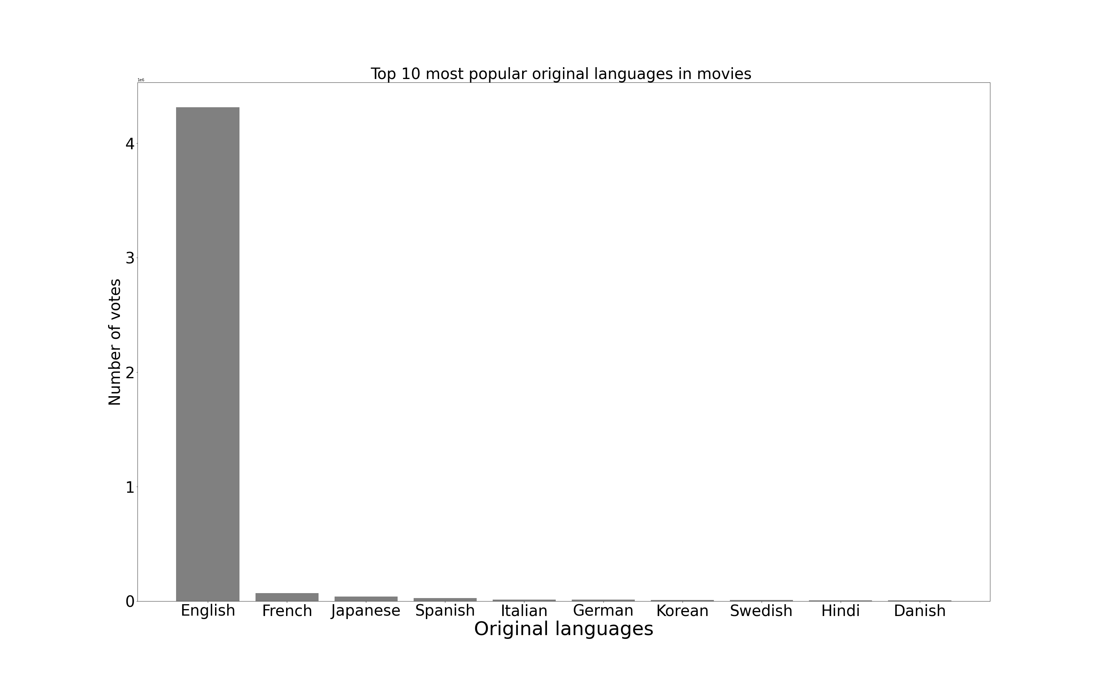
Result

Slide 7
English is the most preferred language as it has the most votes

Slide 8
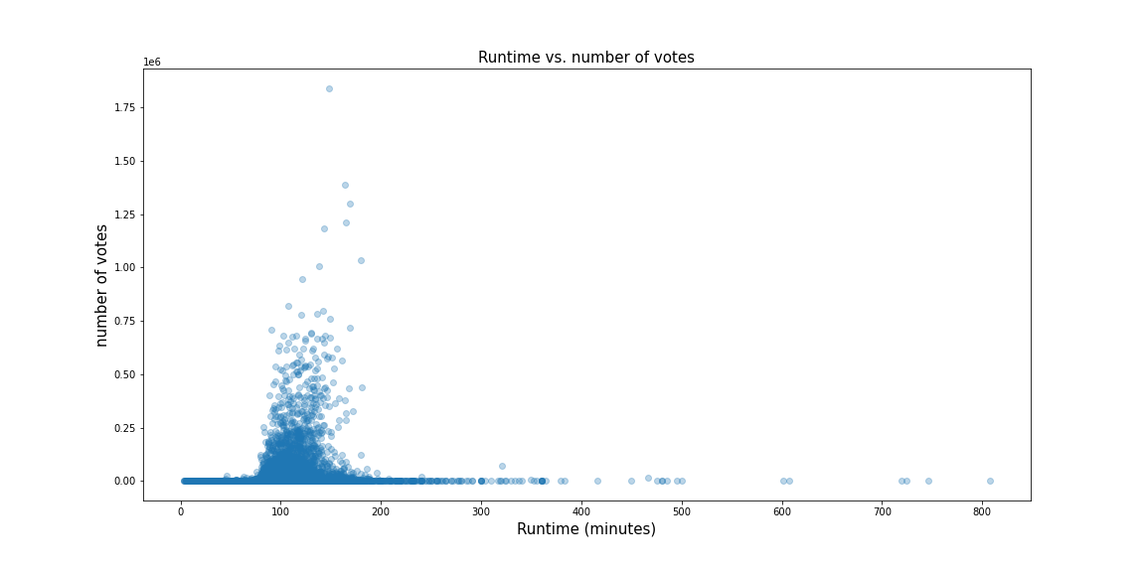
Result

Slide 9
Viewers prefer films with runtime around 90-200 as they are the ones that have the most number of votes compared to very long or short films.

Slide 10
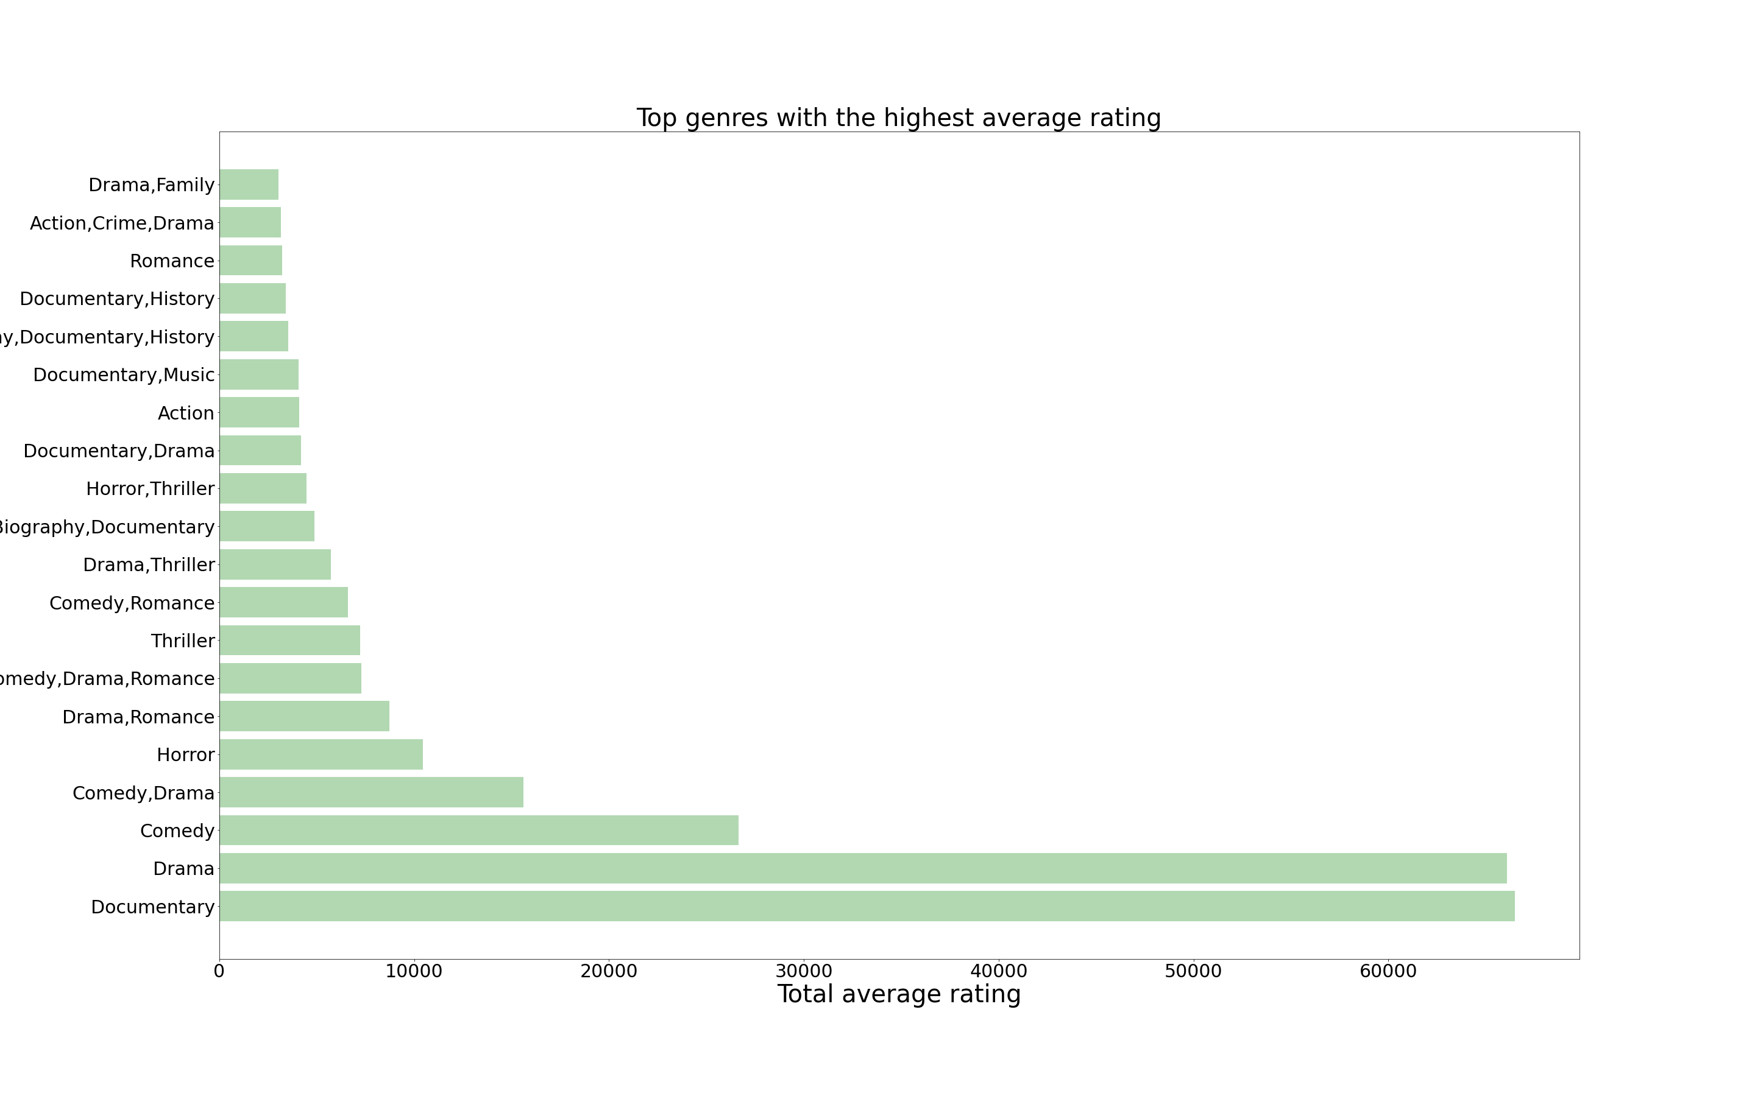
Result

Slide 11
Viewers prefer documentaries and drama as they are the genres with the highest rating

Slide 12
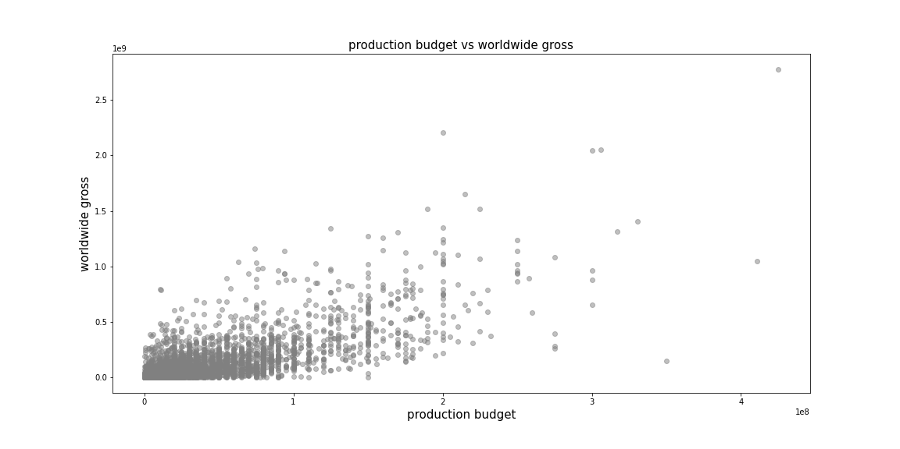
Result

Slide 13
More production cost does not necessarily mean more gross income.

Slide 14
Conclusion
The original language for any films\movies that will produced should most preferably be in English as it has a larger audience.
Produce films with around 90-200 minutes runtime
Aim to produce more films in drama and documentaries genre as they are among the most popular.
More money invested in production of a film does not necessarily mean more gross income. Gross income is dependent on other factors

